Slide 1

Glimpses of Python Graphics - II

Slide 2
Glimpses of Python Graphics
What we have covered so far about making plots:
How to read basic functions from Python libraries in discrete form, create lists from them and then plot them
How to read structured data (rows & columns) from text files from hard disk, create lists from them and plot them
Enhancing the plots with some basic display features.

Slide 3
Glimpses of Python Graphics
What we will cover in today’s lecture:
How to divide your plot area into a number of subplots
Making subplots and adding some features to them
How to make 3-D contour plots
Making wire-mesh plots
Making vector plots.

Slide 4
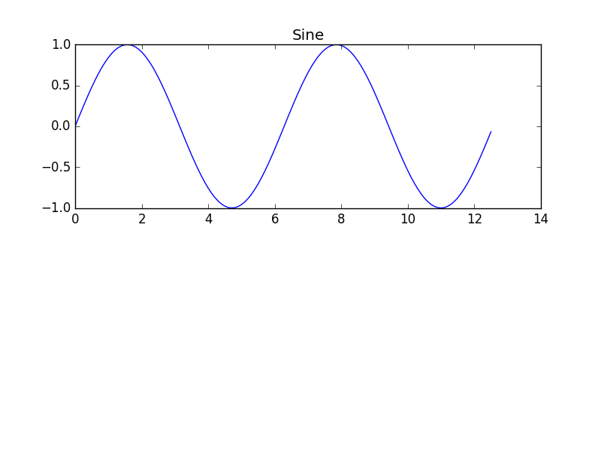
Sub-Plots – Designing your plot area
Start the same way as before, import libraries and prepare lists of discrete data:
import numpy as np
import matplotlib.pyplot as plt
x = np.arange(0, 4 * np.pi, 0.1)
y_sin = np.sin(x)
y_cos = np.cos(x)
Then position the sub-plot within the plotting area:
plt.subplot(2, 1, 1)
plt.plot(x, y_sin, 'b-')
plt.title('Sine')
(2, 1, 1): The first argument denotes number of rows of sub-plots in the plotting area, second, number of columns, and the third denotes position of current sub-plot.

Slide 5
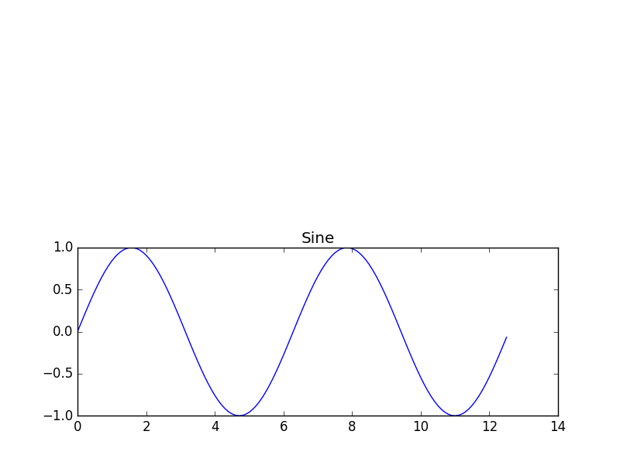
Sub-Plots – Designing your plot area
Start the same way as before, import libraries and prepare lists of discrete data:
import numpy as np
import matplotlib.pyplot as plt
x = np.arange(0, 4 * np.pi, 0.1)
y_sin = np.sin(x)
y_cos = np.cos(x)
Then position the sub-plot within the plotting area:
plt.subplot(2, 1, 2)
plt.plot(x, y_sin, 'b-')
plt.title('Sine')
(2, 1, 2): The first argument denotes number of rows of sub-plots in the plotting area, second, number of columns, and the third denotes position of current sub-plot.

Slide 6
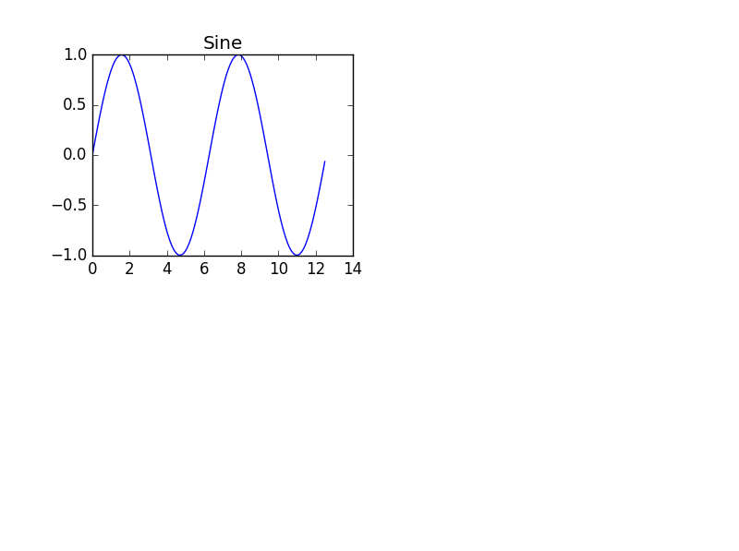
Sub-Plots – Designing your plot area
Start the same way as before, import libraries and prepare lists of discrete data:
import numpy as np
import matplotlib.pyplot as plt
x = np.arange(0, 4 * np.pi, 0.1)
y_sin = np.sin(x)
y_cos = np.cos(x)
Then position the sub-plot within the plotting area:
plt.subplot(2, 2, 1)
plt.plot(x, y_sin, 'b-')
plt.title('Sine')
(2, 2, 1): The first argument denotes number of rows of sub-plots in the plotting area, second, number of columns, and the third denotes position of current sub-plot.

Slide 7
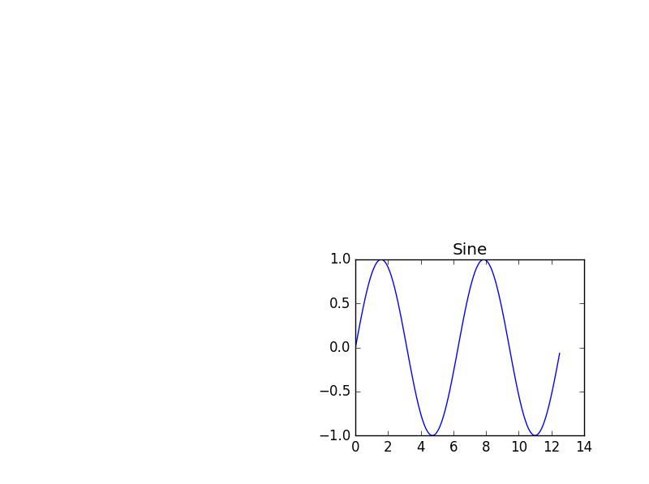
Sub-Plots – Designing your plot area
Start the same way as before, import libraries and prepare lists of discrete data:
import numpy as np
import matplotlib.pyplot as plt
x = np.arange(0, 4 * np.pi, 0.1)
y_sin = np.sin(x)
y_cos = np.cos(x)
Then position the sub-plot within the plotting area:
plt.subplot(2, 2, 4)
plt.plot(x, y_sin, 'b-')
plt.title('Sine')
(2, 2, 4): The first argument denotes number of rows of sub-plots in the plotting area, second, number of columns, and the third denotes position of current sub-plot.

Slide 8
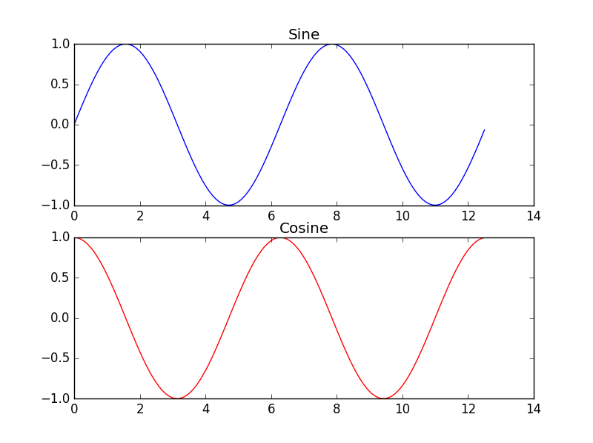
Sub-Plots – Creating the sub-plots
Start the same way as before, import libraries and prepare lists of discrete data:
import numpy as np
import matplotlib.pyplot as plt
x = np.arange(0, 4 * np.pi, 0.1)
y_sin = np.sin(x)
y_cos = np.cos(x)
Then position the sub-plots within the plotting area:
plt.subplot(2, 1, 1)
plt.plot(x, y_sin, 'b-')
plt.title('Sine')
plt.subplot(2, 1, 2)
plt.plot(x, y_cos, 'r-')
plt.title('Cosine')

Slide 9
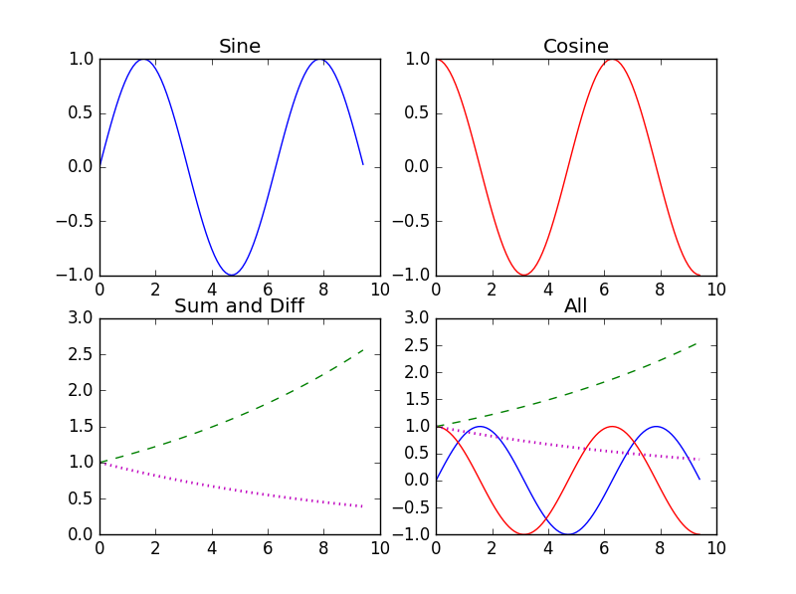
Sub-Plots – Creating more sub-plots
x = np.arange(0, 3 * np.pi, 0.1)
y_sin = np.sin(x)
y_cos = np.cos(x)
y_expp = np.exp(x/10)
y_expm = np.exp(-x/10)
plt.subplot(2, 2, 1)
plt.plot(x, y_sin, 'b-')
plt.title('Sine')
plt.subplot(2, 2, 2)
plt.plot(x, y_cos, 'r-')
plt.title('Cosine')
plt.subplot(2, 2, 3)
plt.plot(x, y_expp, 'g--')
plt.plot(x, y_expm, 'm:', linewidth = 2)
plt.title('Sum and Diff')
plt.subplot(2, 2, 4)
plt.plot(x, y_sin, 'b-')
plt.plot(x, y_cos, 'r-')
plt.plot(x, y_expp, 'g--')
plt.plot(x, y_expm, 'm:', linewidth = 2)
plt.title('All')

Slide 10
Sub-Plots – Creating more sub-plots
So far we have seen how to create sub-plots within a given plot area
We have also seen that multiple plots can be created within these sub-plots, and how some features can be added
We were dealing only with functions available in Python libraries
Now we will create sub-plots out of some real scientific data
We will use the same data seen earlier for creating plots

Slide 11
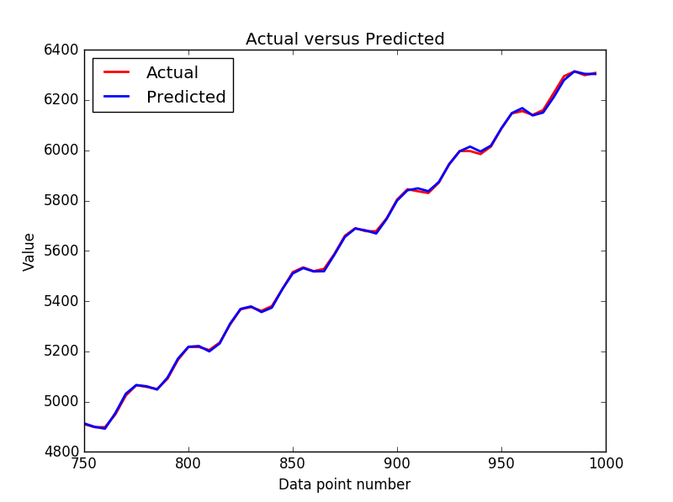
Glimpses of Python Graphics – Reading and Plotting Scientific data
list1 = np.loadtxt("out5_validation_noskew_tanh_8000.txt", delimiter="\t")
n = len(list1)
print "Number of rows in list1 is: ", n
print "Number of columns in list1 is: ", len(list1[0])
s = [[0.0] for i in range(0, 50)]
x = [[0.0] for i in range(0, 50)]
y = [[0.0] for i in range(0, 50)]
for i in range(0, 50):
s[i] =list1[i + 150][0]
x[i] =list1[i + 150][1]
y[i] =list1[i + 150][2]
#plt.plot(x, y)
plt.plot(s, x, 'r-', linewidth = 2)
plt.plot(s, y, 'b-', linewidth = 2)
plt.title('Actual versus Predicted')
plt.legend(['Actual', 'Predicted'], loc = 2)
plt.xlabel('Data point number')
plt.ylabel('Value')
plt.show()

Slide 12
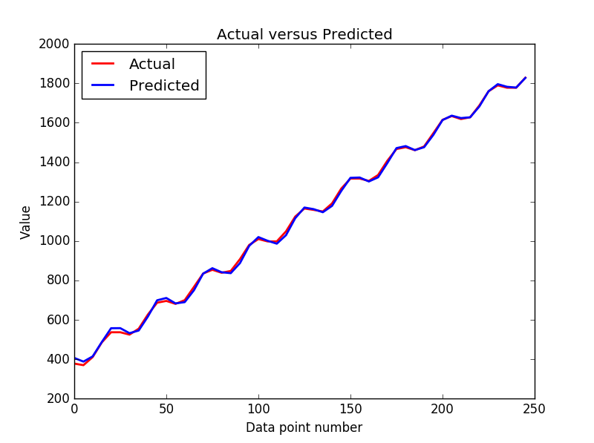
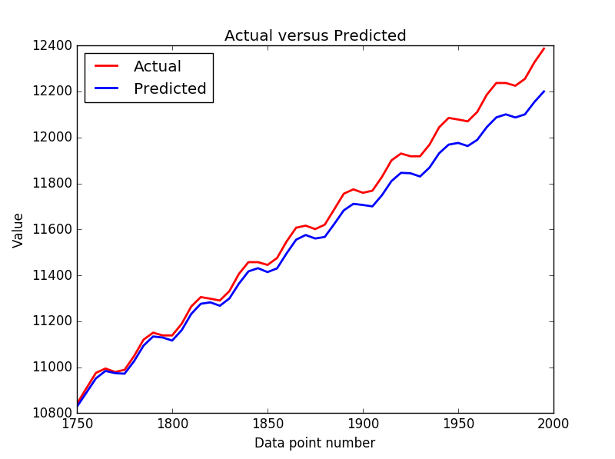
Glimpses of Python Graphics – Reading and Plotting Scientific data
Other sites with lots of information:
http://matplotlib.org/devdocs/examples/
https://github.com/rougier/matplotlib-tutorial

Slide 13
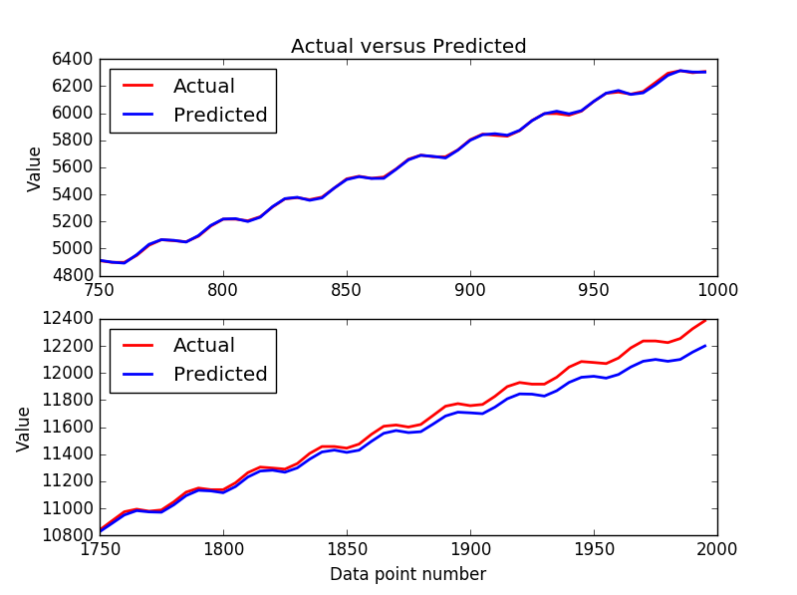
Sub-Plots – on real scientific data
for i in range(0, 50):
s[i] =list1[i + 150][0]
x[i] =list1[i + 150][1]
y[i] =list1[i + 150][2]
plt.subplot(2, 1, 1)
plt.plot(s, x, 'r-', linewidth = 2)
plt.plot(s, y, 'b-', linewidth = 2)
plt.title('Actual versus Predicted')
plt.legend(['Actual', 'Predicted'], loc = 2)
plt.ylabel('Value')
for i in range(0, 50):
s[i] =list1[i + 350][0]
x[i] =list1[i + 350][1]
y[i] =list1[i + 350][2]
plt.subplot(2, 1, 2)
plt.plot(s, x, 'r-', linewidth = 2)
plt.plot(s, y, 'b-', linewidth = 2)
plt.legend(['Actual', 'Predicted'], loc = 2)
plt.xlabel('Data point number')
plt.ylabel('Value')

Slide 14
One last item on sub-plots ….
We will show one last item on sub-plots, before moving on to other items
This deals with laying the basis for animations
Animations are outside the scope of this course, but you can use the provided links to investigate further
First, we will revert to our 4 sub-plots formation ….

Slide 15
Sub-Plots – Creating more sub-plots
x = np.arange(0, 3 * np.pi, 0.1)
y_sin = np.sin(x)
y_cos = np.cos(x)
y_expp = np.exp(x/10)
y_expm = np.exp(-x/10)
plt.subplot(2, 2, 1)
plt.plot(x, y_sin, 'b-')
plt.title('Sine')
plt.subplot(2, 2, 2)
plt.plot(x, y_cos, 'r-')
plt.title('Cosine')
plt.subplot(2, 2, 3)
plt.plot(x, y_expp, 'g--')
plt.plot(x, y_expm, 'm:', linewidth = 2)
plt.title('Sum and Diff')
plt.subplot(2, 2, 4)
plt.plot(x, y_sin, 'b-')
plt.plot(x, y_cos, 'r-')
plt.plot(x, y_expp, 'g--')
plt.plot(x, y_expm, 'm:', linewidth = 2)
plt.title('All')

Slide 16
Sub-Plots – Creating more sub-plots, and saving each created object
x = np.arange(0, 3 * np.pi, 0.1)
y_sin = np.sin(x)
y_cos = np.cos(x)
y_expp = np.exp(x/10)
y_expm = np.exp(-x/10)
p11 = plt.subplot(2, 2, 1)
l1 = plt.plot(x, y_sin, 'b-')
t1 = plt.title('Sine')
p12 = plt.subplot(2, 2, 2)
l2 = plt.plot(x, y_cos, 'r-')
t2 = plt.title('Cosine')
p21 = plt.subplot(2, 2, 3)
l3 = plt.plot(x, y_expp, 'g--')
l4 = plt.plot(x, y_expm, 'm:', linewidth = 2)
t3 =plt.title('Sum and Diff')
p22 = plt.subplot(2, 2, 4)
l1 = plt.plot(x, y_sin, 'b-')
l2 = plt.plot(x, y_cos, 'r-')
l3 = plt.plot(x, y_expp, 'g--')
l4 = plt.plot(x, y_expm, 'm:', linewidth = 2)
t4 = plt.title('All')

Slide 17
Contour plots – in 2.5D and 3D
So far all our plots have dealt with two dimensions – an X and an Y
Now we will look at creating 3-Dimensional plots, given a rectangular grid of X- and Y- dimensions, we have a function Z(X, Y) defined on that grid, which we shall try to visualize
But first, we shall see how the rectangular grid in X- and Y- dimensions is defined
For that, we shall use the (X, Y) = meshgrid(x, y) function

Slide 18
Understanding the meshgrid(x, y) function
Belongs to the numpy lib, we call as (X, Y) = np.meshgrid(x, y)
x is vector of x-values (usually, but not necessarily, of constant interval); thus x is a one-dimensional list
y is a vector of y-values
Imagine a 2-D grid of lines that are parallel to the x- and y- axes
All lines parallel to y-axis are of constant x (for each line)
The list x contains these x-values
Similarly, lines parallel to x-axis are of constant y, and the list y contains these values
But on the 2-D grid these lines intersect, into (len(x) x len(y)) number of points; let N = (len(x) x len(y))
The matrix X contains the x-values of all these N points; X is a 2-D list of len(y) columns and len(x) rows; all rows are identical
Likewise matrix Y contains y-values; all columns are identical.

Slide 19
Understanding the meshgrid(x, y) function: example
>>> x = numpy.arange(-4, 5)
>>> y = numpy.arange(-6, 8, 2)
>>> X,Y = numpy.meshgrid(x,y)
>>> print X
[[-4 -3 -2 -1 0 1 2 3 4]
[-4 -3 -2 -1 0 1 2 3 4]
[-4 -3 -2 -1 0 1 2 3 4]
[-4 -3 -2 -1 0 1 2 3 4]
[-4 -3 -2 -1 0 1 2 3 4]
[-4 -3 -2 -1 0 1 2 3 4]
[-4 -3 -2 -1 0 1 2 3 4]]
>>> print Y
[[-6 -6 -6 -6 -6 -6 -6 -6 -6]
[-4 -4 -4 -4 -4 -4 -4 -4 -4]
[-2 -2 -2 -2 -2 -2 -2 -2 -2]
[ 0 0 0 0 0 0 0 0 0]
[ 2 2 2 2 2 2 2 2 2]
[ 4 4 4 4 4 4 4 4 4]
[ 6 6 6 6 6 6 6 6 6]]
>>> print Z(X, Y) = (X**2 + Y**2)
[[52 45 40 37 36 37 40 45 52]
[32 25 20 17 16 17 20 25 32]
[20 13 8 5 4 5 8 13 20]
[16 9 4 1 0 1 4 9 16]
[20 13 8 5 4 5 8 13 20]
[32 25 20 17 16 17 20 25 32]
[52 45 40 37 36 37 40 45 52]]

Slide 20
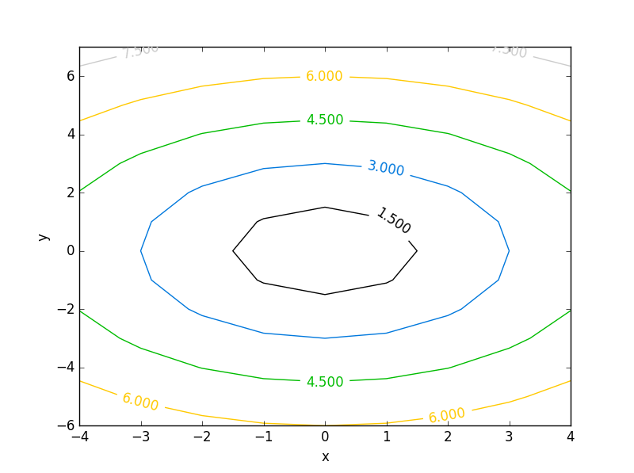
The first contour plot
import numpy as np
import matplotlib.pyplot as plt
x = np.arange(-4, 5, 1)
y = np.arange(-6, 8, 1)
(X,Y) = np.meshgrid(x,y)
a = np.sqrt(X**2 + Y**2)
c = plt.contour(x, y, a)
l = plt.clabel(c)
lx = plt.xlabel("x")
ly = plt.ylabel("y")
plt.show()

Slide 21
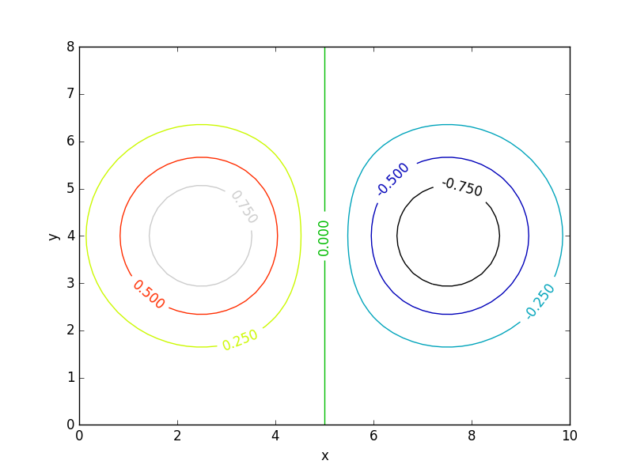
The second contour plot
import numpy as np
import matplotlib.pyplot as plt
x = np.linspace(0,10,51)
y = np.linspace(0,8,41)
(X,Y) = np.meshgrid(x,y)
a = np.exp(-((X - 2.5)**2 + (Y - 4)**2)/4) - np.exp(-((X - 7.5)**2 + (Y - 4)**2)/4)
c = plt.contour(x, y, a)
l = plt.clabel(c)
lx = plt.xlabel("x")
ly = plt.ylabel("y")
plt.show()

Slide 22
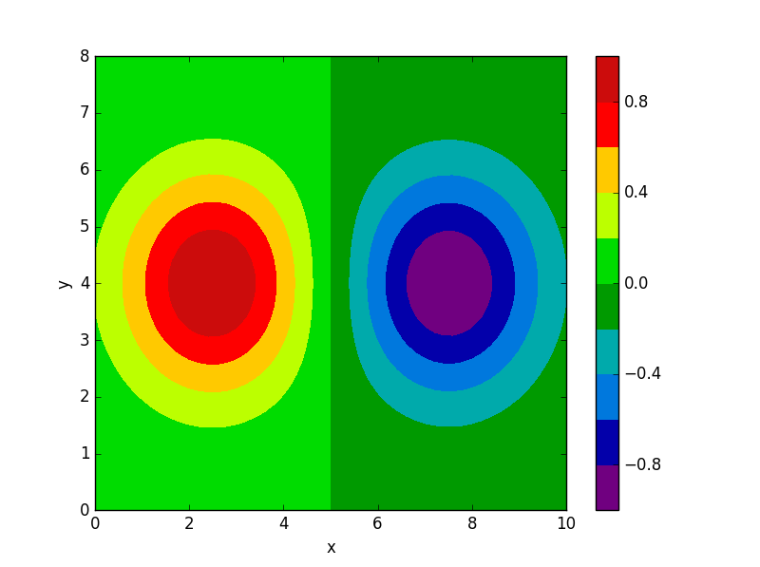
Second contour plot – coloured, discontinuous
import numpy as np
import matplotlib.pyplot as plt
x = np.linspace(0, 10, 51)
y = np.linspace(0, 8, 41)
(X,Y) = np.meshgrid(x,y)
a = np.exp(-((X - 2.5)**2 + (Y - 4)**2)/4) - np.exp(-((X - 7.5)**2 + (Y - 4)**2)/4)
c = plt.contourf(x, y, a, np.linspace(-1, 1, 11))
b = plt.colorbar(c, orientation='vertical')
#c = plt.contour(x, y, a)
#l = plt.clabel(c)
lx = plt.xlabel("x")
ly = plt.ylabel("y")
plt.show()

Slide 23
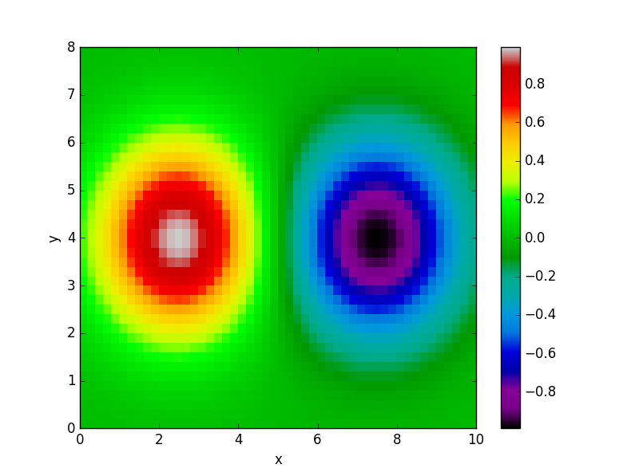
Second contour plot – coloured, continuous
import numpy as np
import matplotlib.pyplot as plt
x = np.linspace(0, 10, 51)
y = np.linspace(0, 8, 41)
(X,Y) = np.meshgrid(x,y)
a = np.exp(-((X - 2.5)**2 + (Y - 4)**2)/4) - np.exp(-((X - 7.5)**2 + (Y - 4)**2)/4)
ac = 0.25 * (a[:-1, :-1] + a[:-1, 1:] + a[1:, :-1] + a[1:, 1:])
c = plt.pcolor(x, y, ac)
b = plt.colorbar(c, orientation='vertical')
q = plt.spectral()
lx = plt.xlabel("x")
ly = plt.ylabel("y")
ax = plt.axis([0,10,0,8])
plt.show()

Slide 24
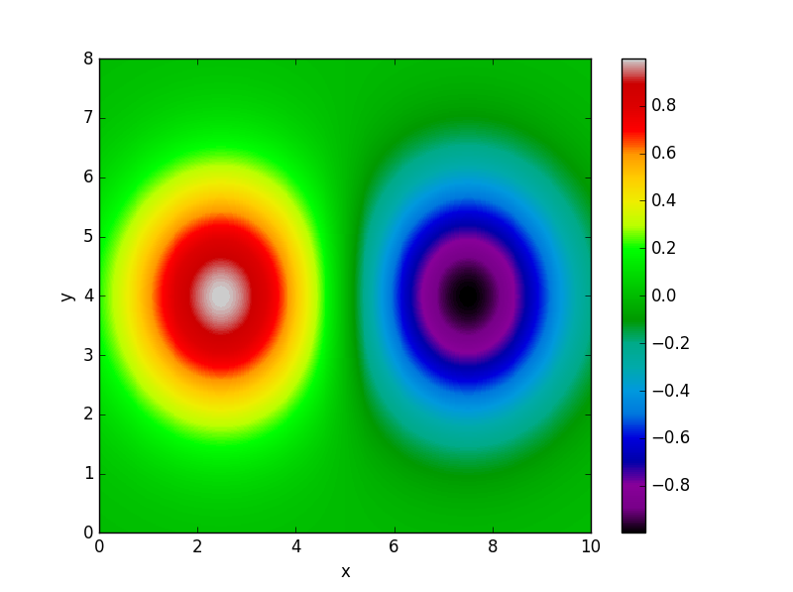
Second contour plot – coloured, continuous, high-resolution
import numpy as np
import matplotlib.pyplot as plt
x = np.linspace(0, 10, 510)
y = np.linspace(0, 8, 410)
(X,Y) = np.meshgrid(x,y)
a = np.exp(-((X - 2.5)**2 + (Y - 4)**2)/4) - np.exp(-((X - 7.5)**2 + (Y - 4)**2)/4)
ac = 0.25 * (a[:-1, :-1] + a[:-1, 1:] + a[1:, :-1] + a[1:, 1:])
c = plt.pcolor(x, y, ac)
b = plt.colorbar(c, orientation='vertical')
q = plt.spectral()
lx = plt.xlabel("x")
ly = plt.ylabel("y")
ax = plt.axis([0,10,0,8])
plt.show()

Slide 25
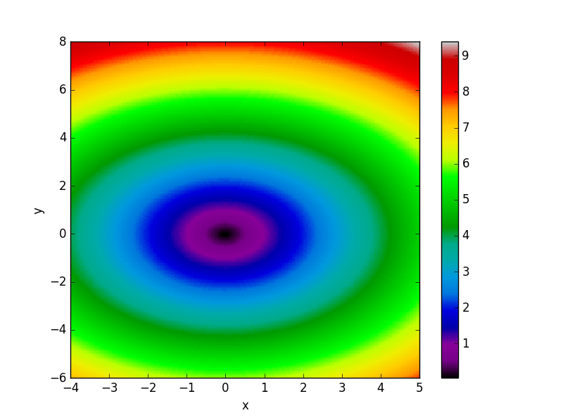
First contour plot – coloured, continuous, high-resolution
import numpy as np
import matplotlib.pyplot as plt
x = np.linspace(-4, 5, 200)
y = np.linspace(-6, 8, 200)
(X,Y) = np.meshgrid(x,y)
a = np.sqrt(X**2 + Y**2)
ac = 0.25 * (a[:-1, :-1] + a[:-1, 1:] + a[1:, :-1] + a[1:, 1:])
c = plt.pcolor(x, y, ac)
b = plt.colorbar(c, orientation='vertical')
q = plt.spectral()
#c = plt.contour(x, y, a)
#l = plt.clabel(c)
lx = plt.xlabel("x")
ly = plt.ylabel("y")
plt.show()
But you still need to imagine the hills &
valleys in the 3-D field, isn’t it?

Slide 26
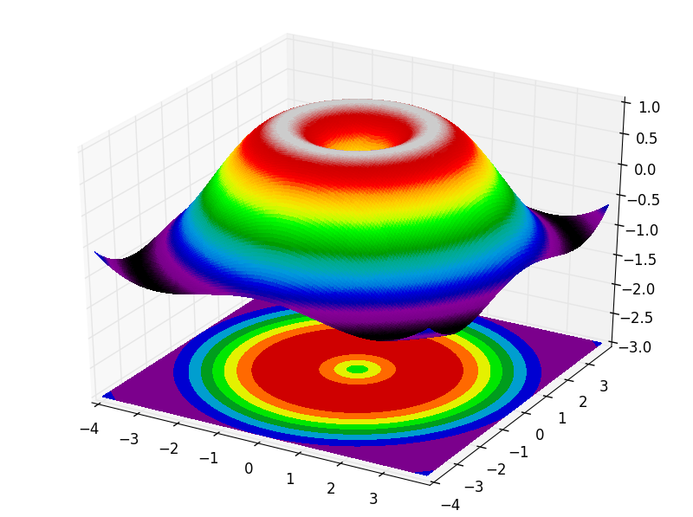
First 3-D contour plot – coloured, continuous, high-resolution
import numpy as np
import matplotlib.pyplot as plt
from mpl_toolkits.mplot3d import Axes3D
fig = plt.figure()
ax = Axes3D(fig)
x = np.arange(-4, 4, 0.05)
y = np.arange(-4, 4, 0.05)
X, Y = np.meshgrid(x, y)
R = np.sqrt(X**2 + Y**2)
Z = np.sin(R)
ax.plot_surface(X, Y, Z, rstride=1, cstride=1, cmap=plt.cm.spectral, linewidth=0, antialiased=False)
ax.contourf(X, Y, Z, zdir='z', offset=-3, cmap=plt.cm.spectral)
ax.set_zlim(-3,1)
plt.show()

Slide 27
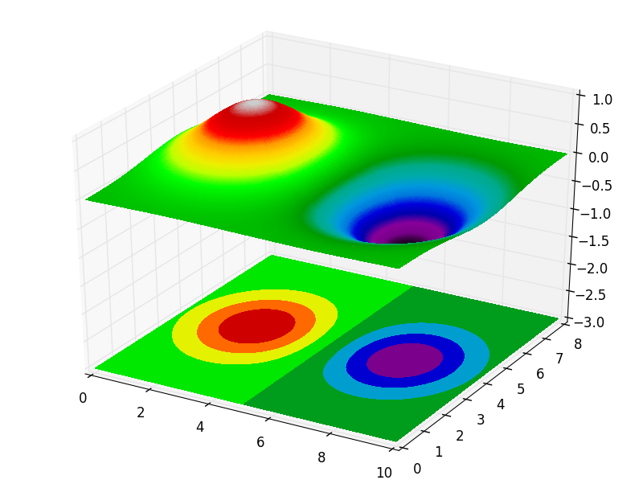
Second 3-D contour plot – coloured, continuous, high-resolution
import numpy as np
import matplotlib.pyplot as plt
from mpl_toolkits.mplot3d import Axes3D
fig = plt.figure()
ax = Axes3D(fig)
x = np.linspace(0, 10, 255)
y = np.linspace(0, 8, 205)
X, Y = np.meshgrid(x, y)
R = np.exp(-((X - 2.5)**2 + (Y - 4)**2)/4) - np.exp(-((X - 7.5)**2 + (Y - 4)**2)/4)
Z = R
ax.plot_surface(X, Y, Z, rstride=1, cstride=1, cmap=plt.cm.spectral, linewidth = 0, antialiased = False)
ax.contourf(X, Y, Z, zdir='z', offset=-3, cmap=plt.cm.spectral)
ax.set_zlim(-3,1)
plt.show()

